Slide 1

What is the 311 Service Line?
311 is a non-emergency phone number that connects callers to local government services and information. It's available in many cities in the United States and Canada, as well as some cities in other countries. The Federal Communications Commission (FCC) reserved the number in 1997
New York City
311 Service Line

Slide 2
Team Members
Yesmelin Perdomo
Amanda Lor
Alyssa Jones
Daniel Gomes
Asmae Bouazzaoui
What is the 311 Service Line?
311 is a special telephone number supported in many communities in Canada and the United States. The number provides access to non-emergency municipal services accessible by most Cell phone companies as well as Land lines
The telephone number 3-1-1 creates a central hub for local subscribers to access a variety of city services. It is intended, in part, to divert routine inquiries and non-urgent community concerns from the 9-1-1 number which is reserved for emergency service. A promotional website for 3-
New York City
311 Service Line

Slide 3


Project Goals.
How has the flow of incidents been during the first quarter (January-March) of this year?
What are the top 10 complaints in NYC for this first quarter, and how have they fluctuated?
What is the average response time per complaint during this period?
Which borough received the highest volume of 311 calls, and what were the top calls in each borough?
Which agencies are the busiest and are they working effectively? How does this relate to the previous analysis? What is the trash situation in NYC?
Team Members
Yesmelin Perdomo
Amanda Lor
Alyssa Jones
Daniel
What is the 311 Service Line?
311 is a special telephone number supported in many communities in Canada and the United States. The number provides access to non-emergency municipal services accessible by most Cell phone companies as well as Land lines
The telephone number 3-1-1 creates a central hub for local subscribers to access a variety of city services. It is intended, in part, to divert routine inquiries and non-urgent community concerns from the 9-1-1 number which is reserved for emergency service.

Slide 4
What is the 311 Service Line?
311 is a special telephone number supported in many communities in Canada and the United States. The number provides access to non-emergency municipal services accessible by most Cell phone companies as well as Land lines
The telephone number 3-1-1 creates a central hub for local subscribers to access a variety of city services. It is intended, in part, to divert routine inquiries and non-urgent community concerns from the 9-1-1 number which is reserved for emergency service. A promotional website for 3-
Project Goals.
How has the flow of incidents been during the first quarter (January-March) of this year?
What are the top 10 complaints in NYC for this first quarter, and how have they fluctuated?
What is the average response time per complaint during this period?
Which borough received the highest volume of 311 calls, and what were the top calls in each borough?
Which agencies are the busiest and are they working effectively? How does this relate to the previous analysis? What is the trash situation in NYC?

Slide 5
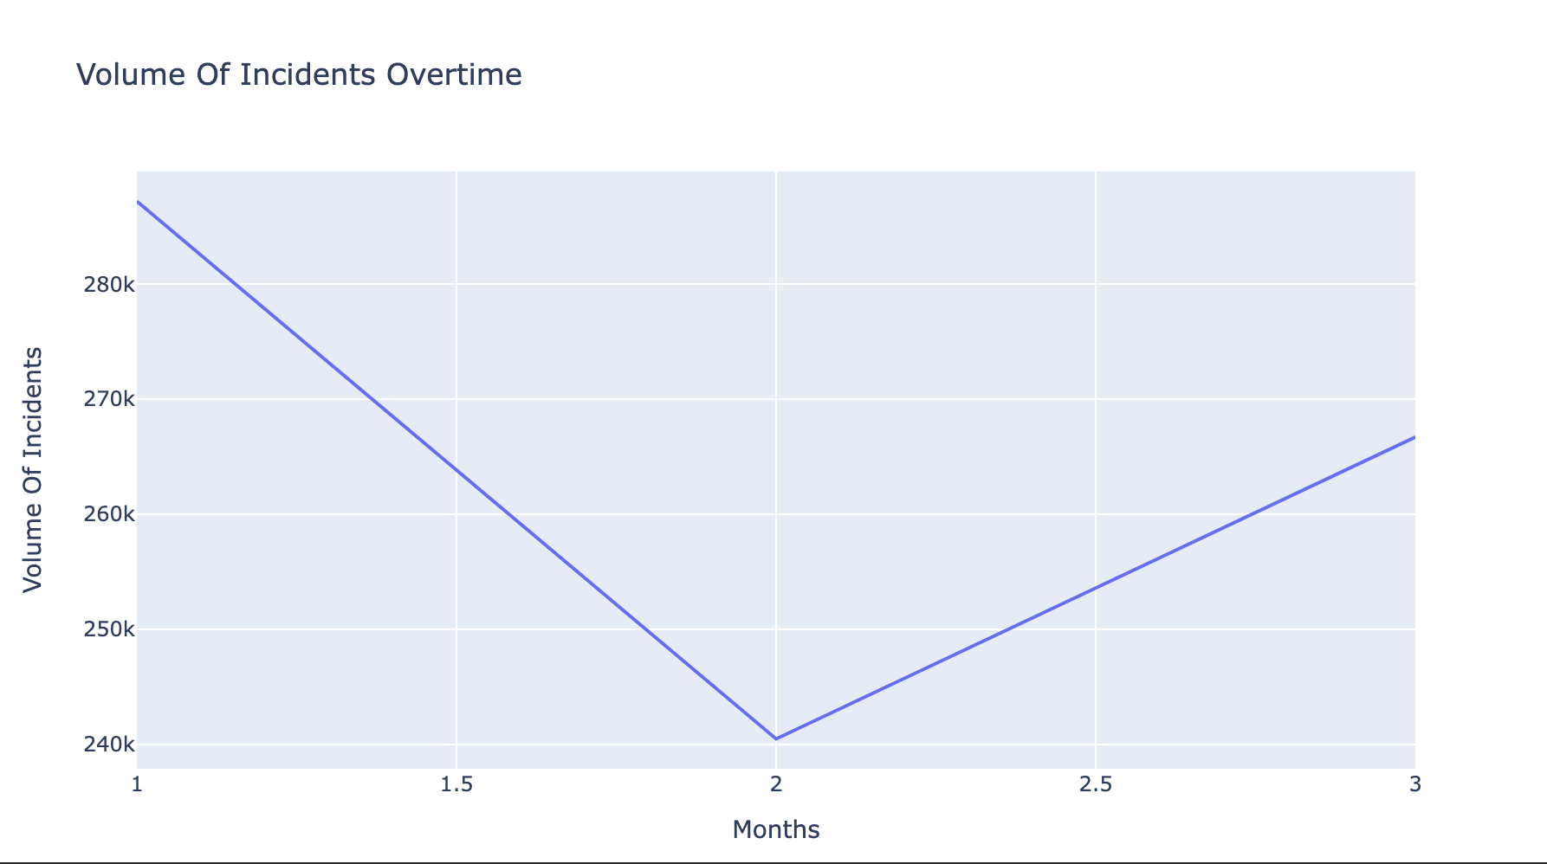


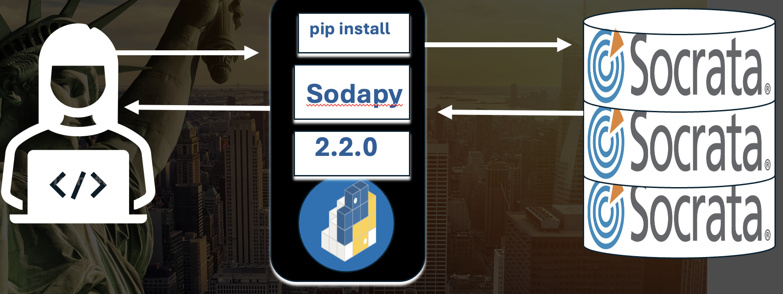

Incidents volume overtime?
pip install
Sodapy
2.2.0
Team #3
Team #3

Slide 6
Incidents volume overtime?
Incidents Volume Overtime?

Slide 7
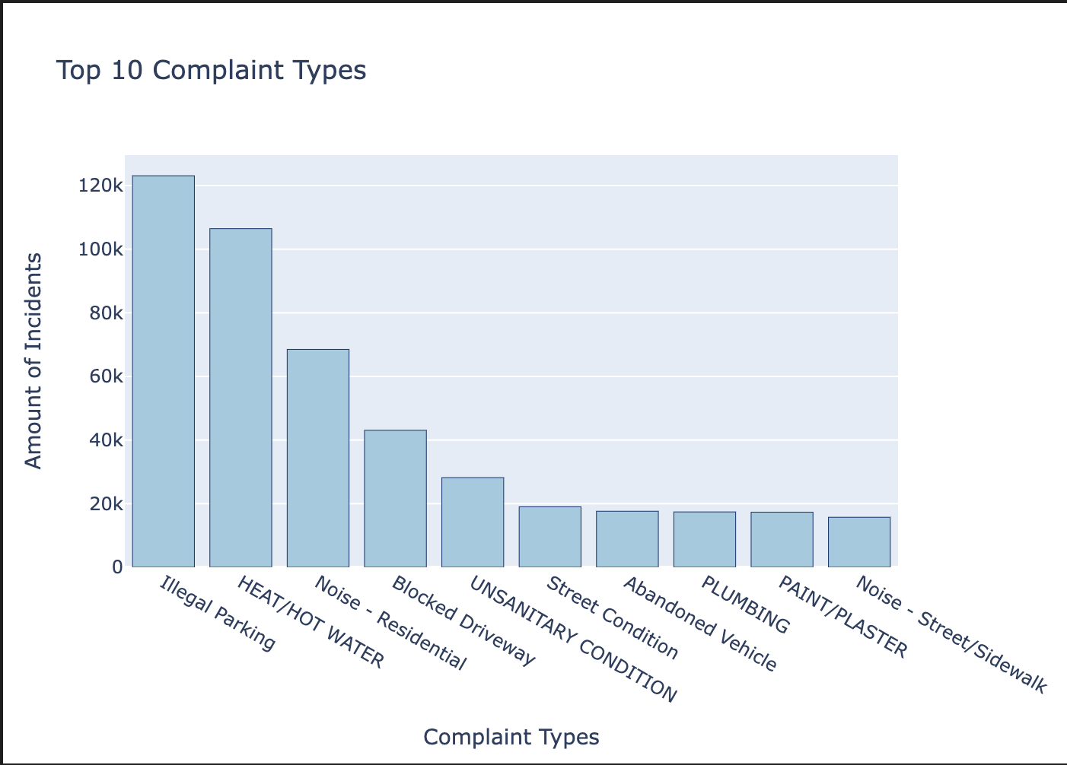
Top 10 Complaint Types in NYC?
Top 10 Complaint Types In NYC?

Slide 8
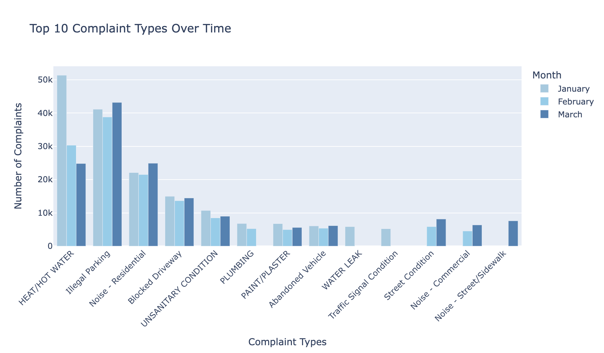
Top 10 Complaint Types (first quarter of this year)
Team Members
Yesmelin Perdomo
Amanda Lor
Alyssa Jones
Daniel

Slide 9
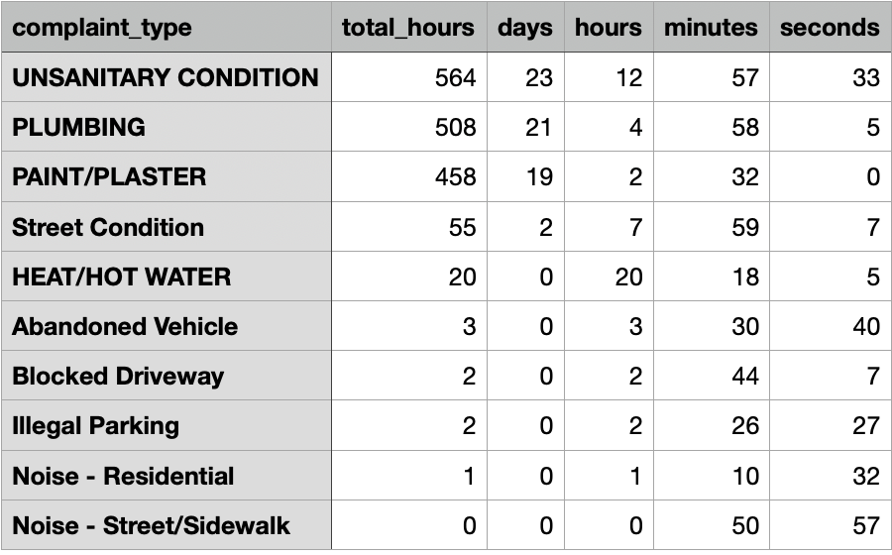
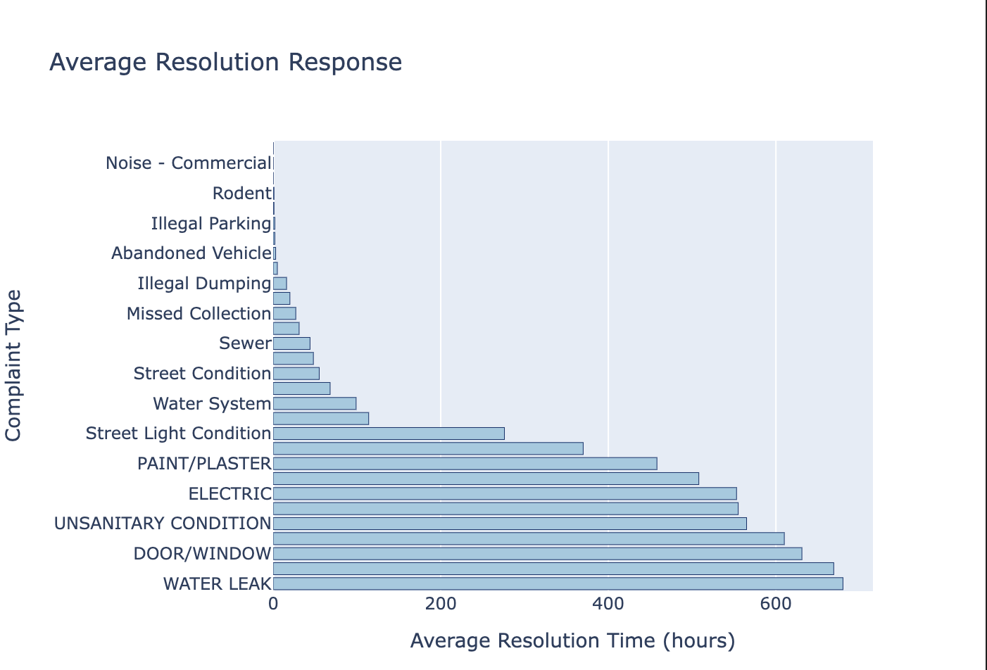
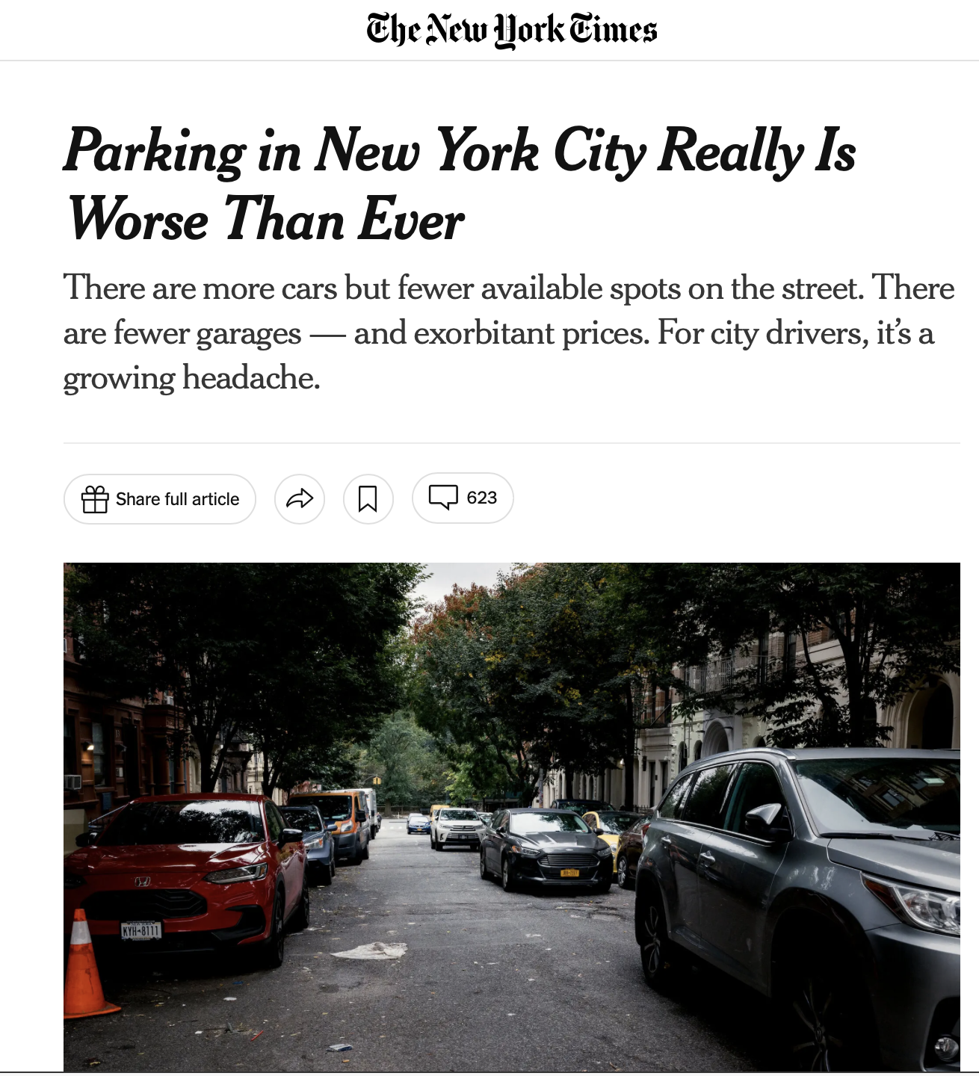
Top 10 Average Response Time
Team Members
Yesmelin Perdomo
Amanda Lor
Alyssa Jones
Daniel

Slide 10
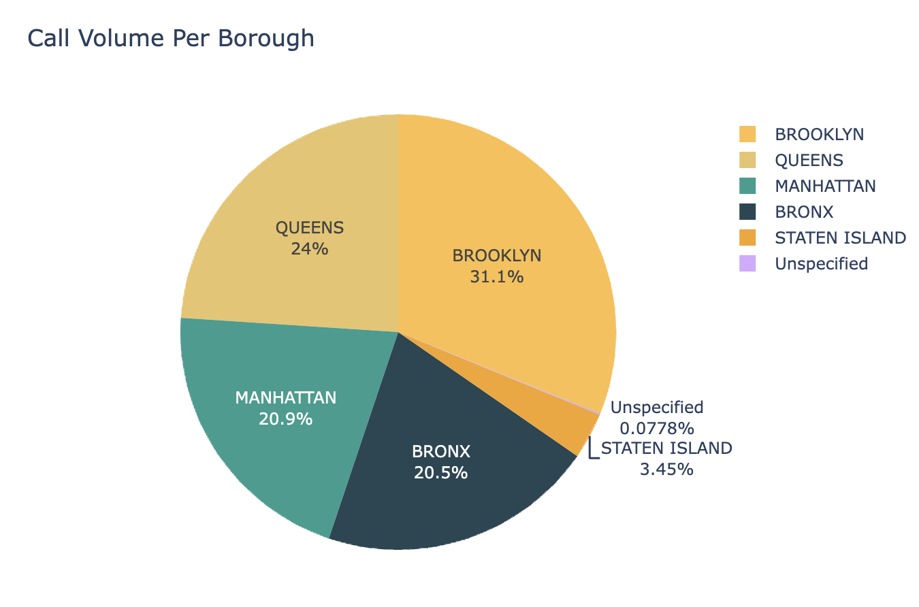
Incidents Volume Per Borough
Team Members
Yesmelin Perdomo
Amanda Lor
Alyssa Jones
Daniel

Slide 11
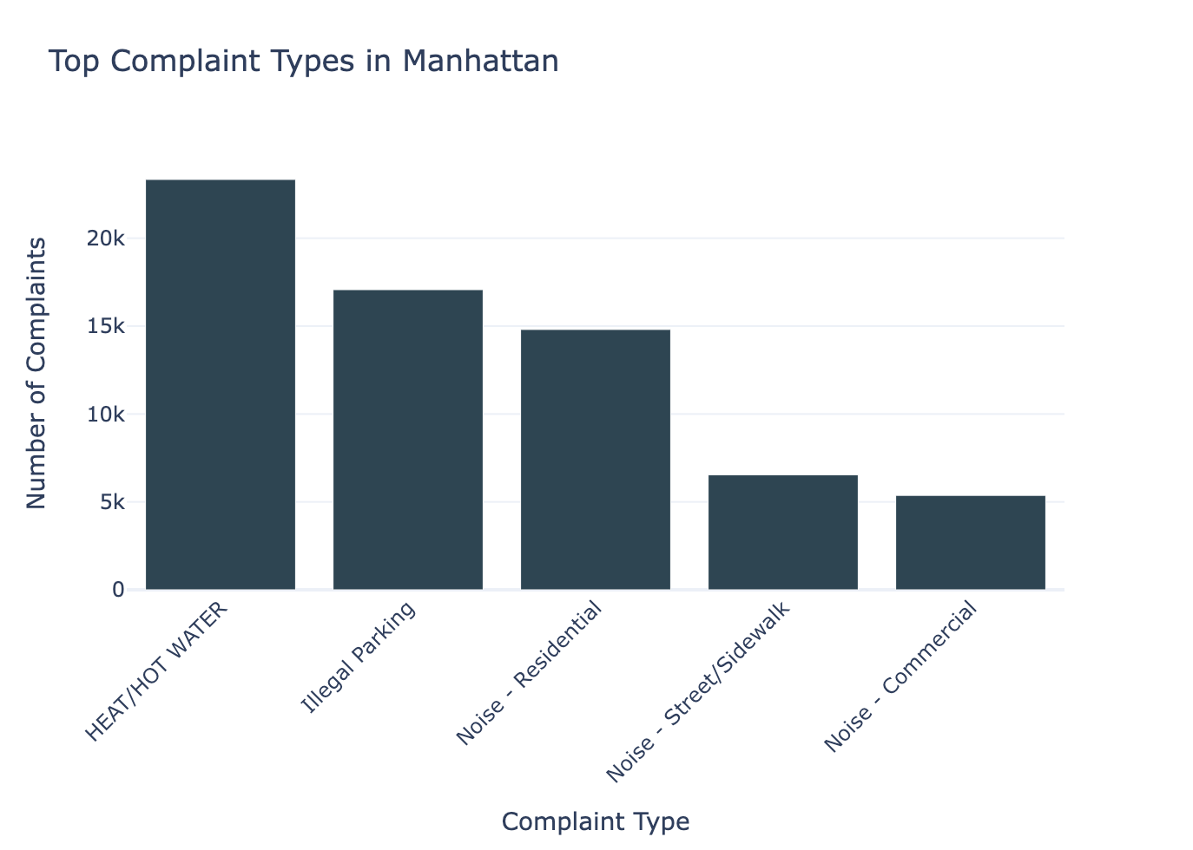
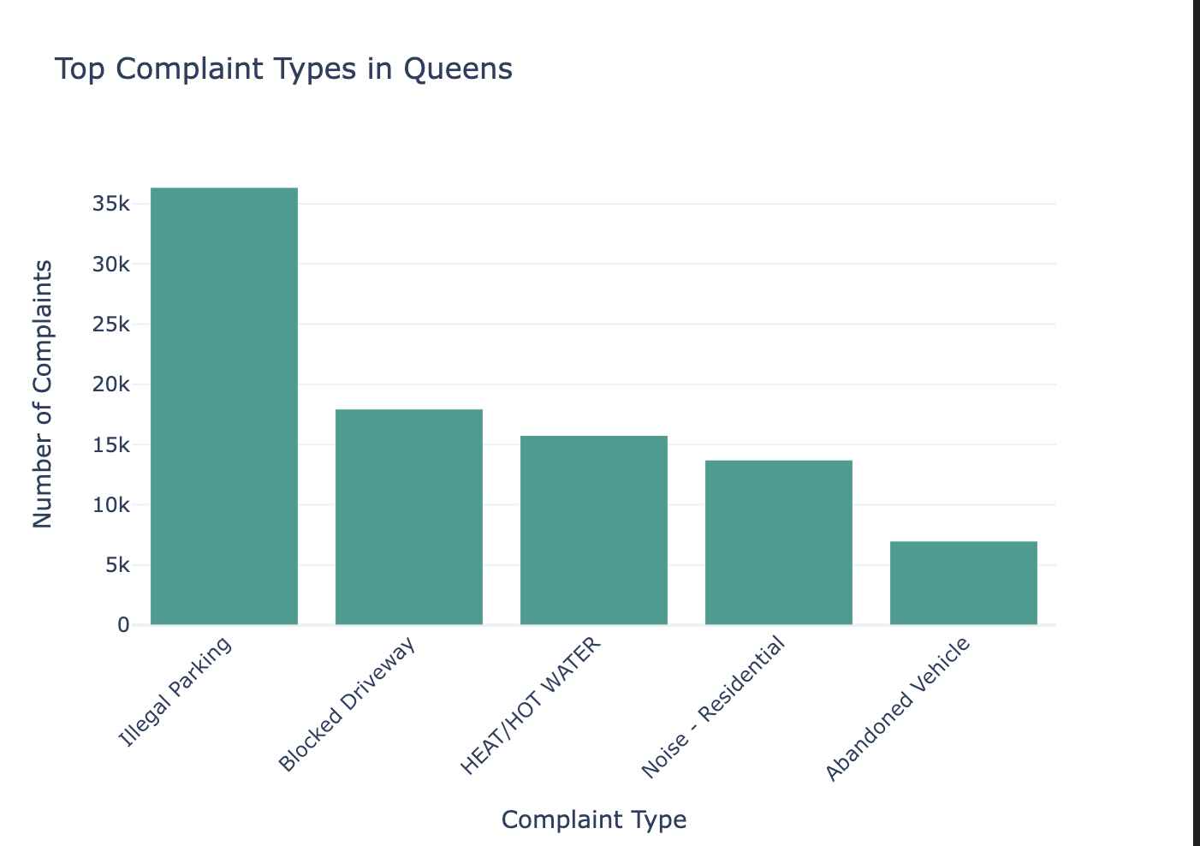
Top 5 Calls Per Borough
Team Members
Yesmelin Perdomo
Amanda Lor
Alyssa Jones
Daniel

Slide 12
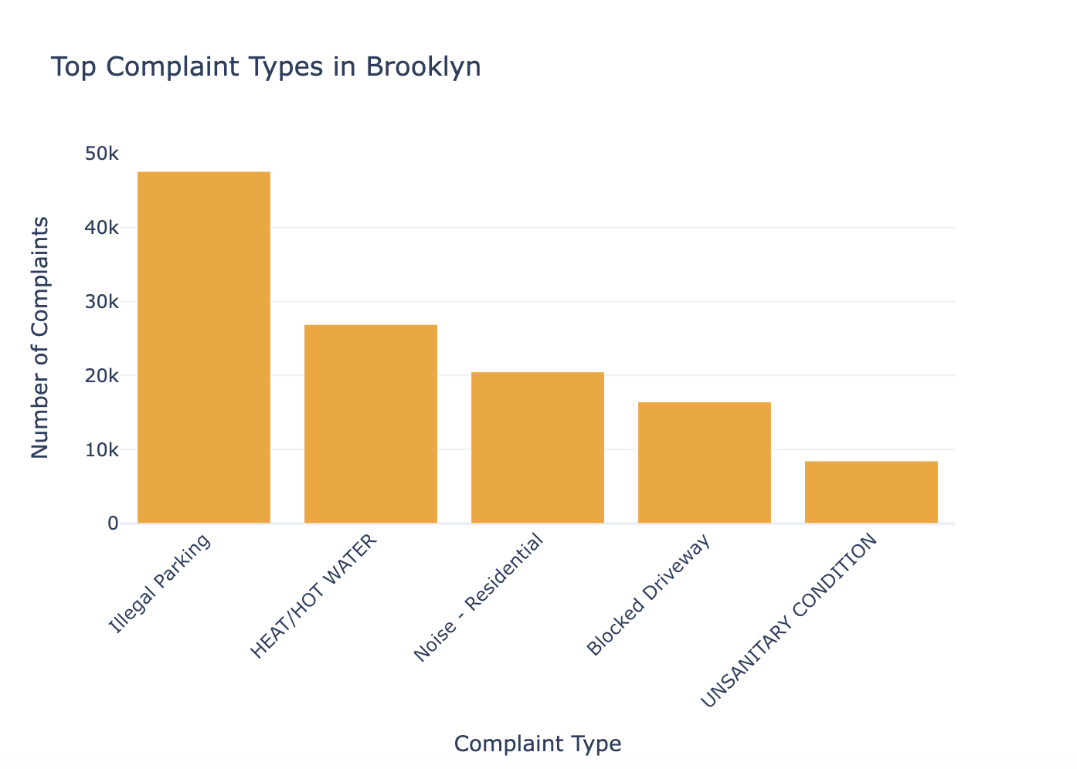
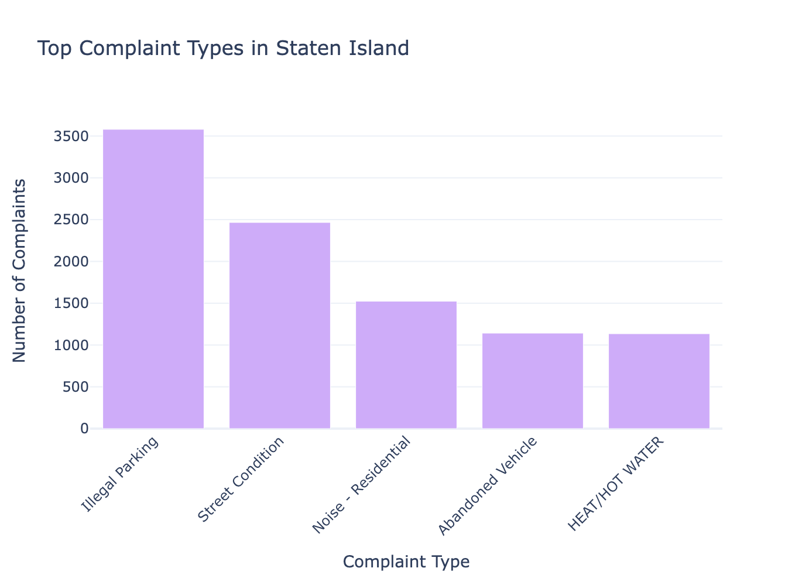
Top 5 Calls Per Borough
Team Members
Yesmelin Perdomo
Amanda Lor
Alyssa Jones
Daniel

Slide 13
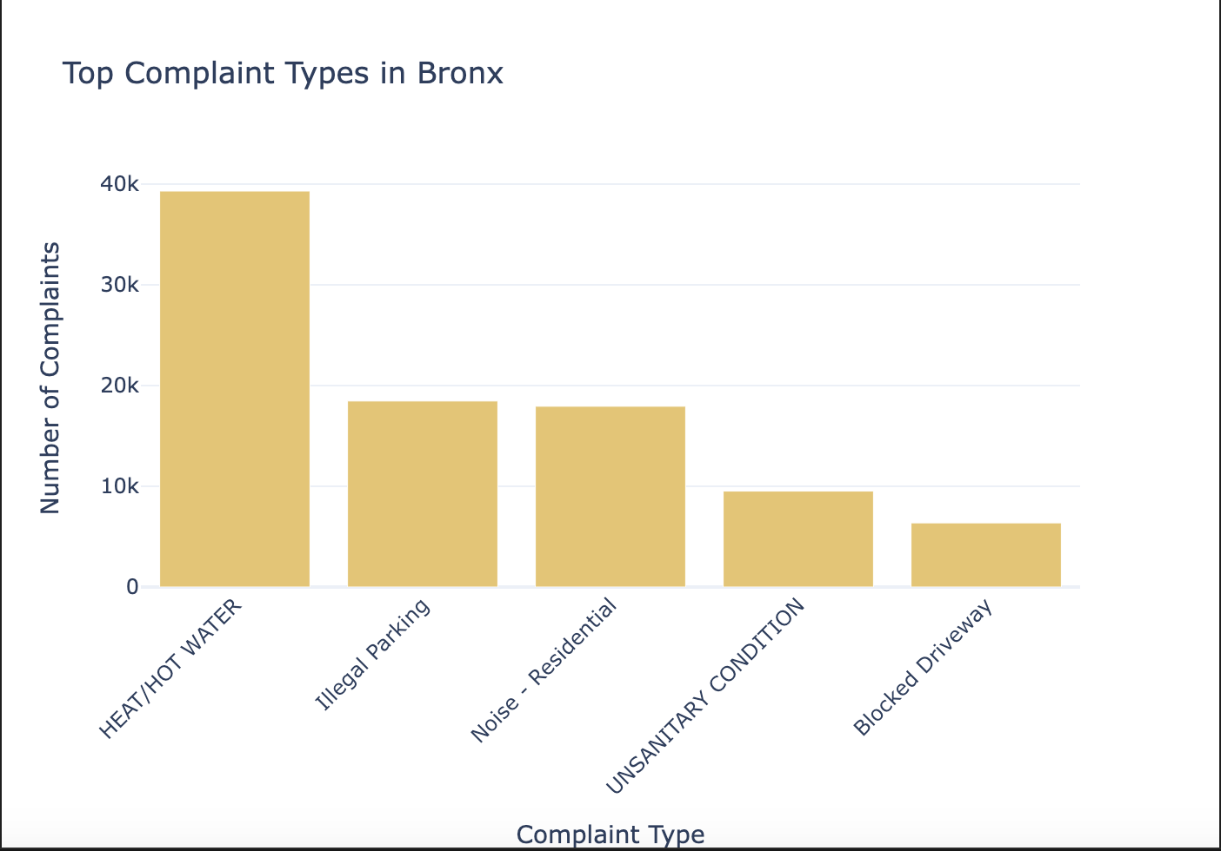
Top 5 Calls Per Borough
Team Members
Yesmelin Perdomo
Amanda Lor
Alyssa Jones
Daniel

Slide 14
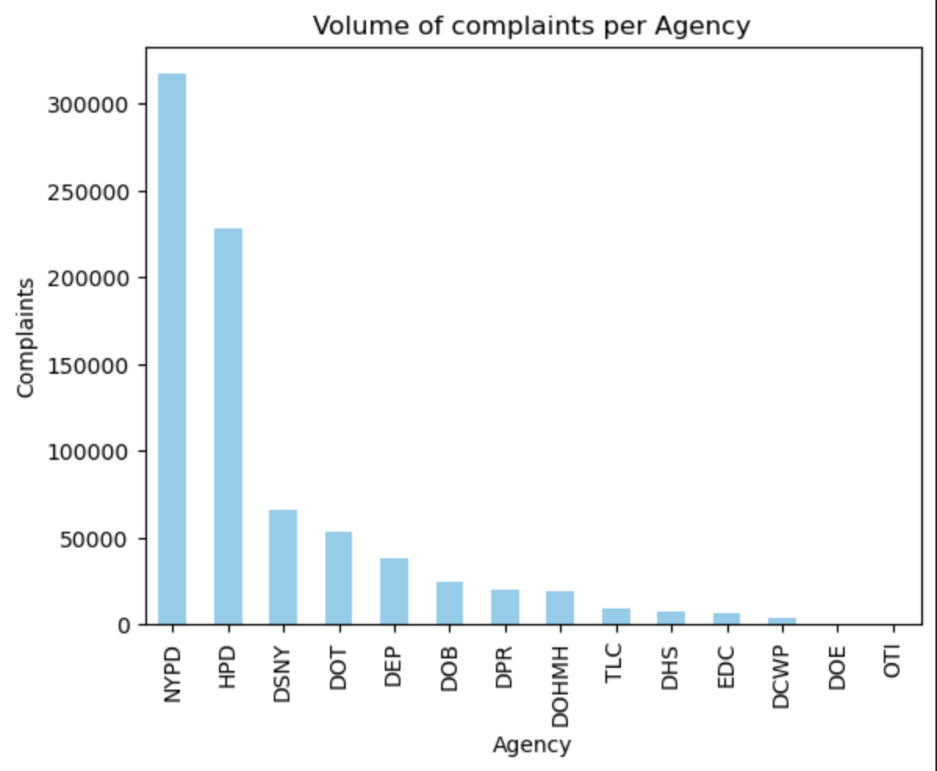
NYC 311 Agencies
Team Members
Yesmelin Perdomo
Amanda Lor
Alyssa Jones
Daniel

Slide 15
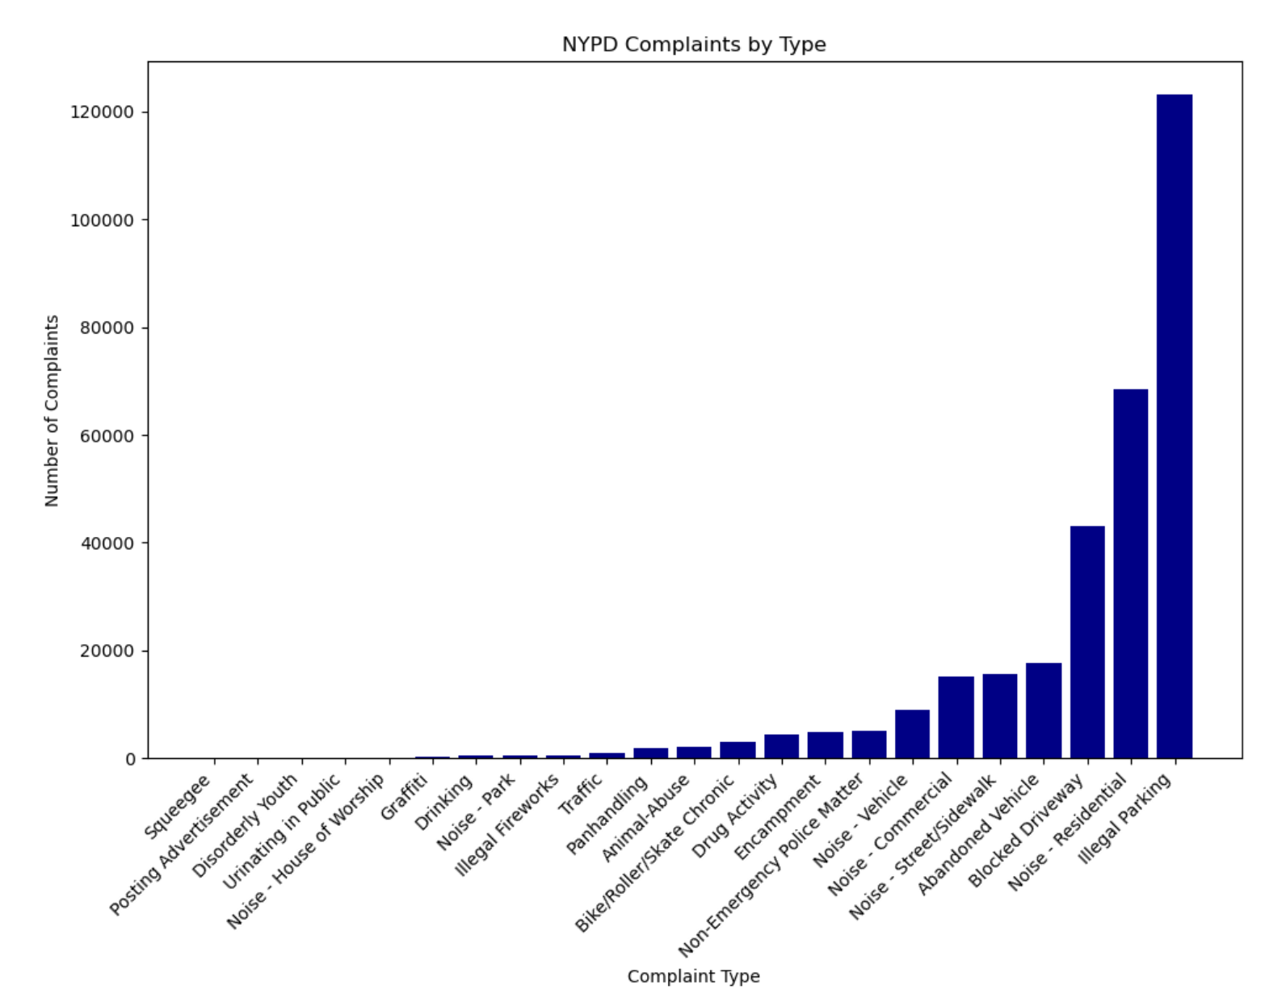
NYPD, HPD & DSNY Analysis
Team Members
Yesmelin Perdomo
Amanda Lor
Alyssa Jones
Daniel

Slide 16
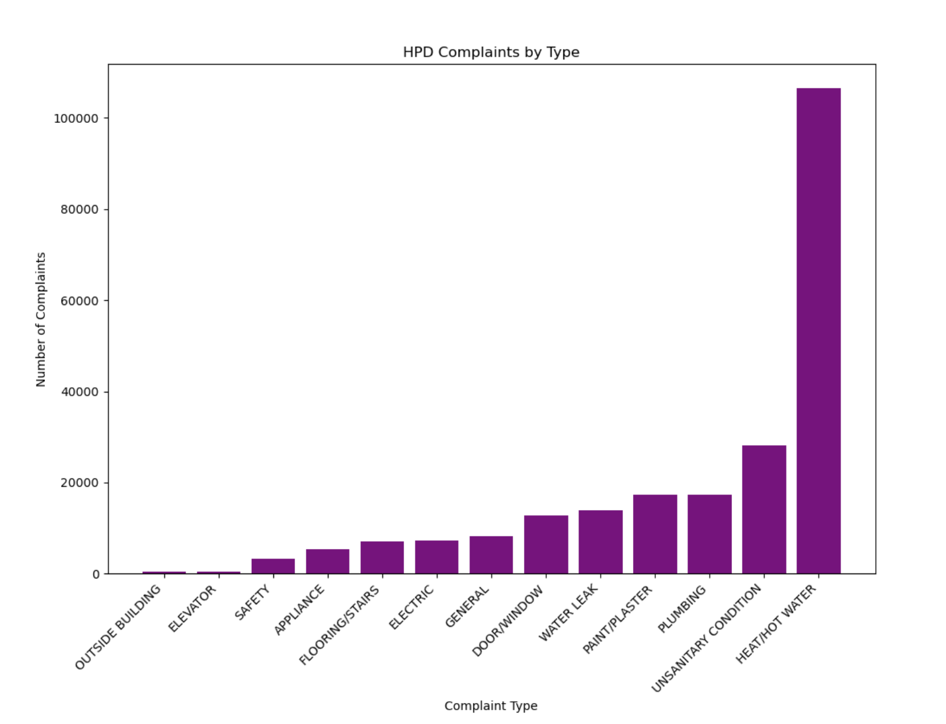
NYPD, HPD & DSNY Analysis
Team Members
Yesmelin Perdomo
Amanda Lor
Alyssa Jones
Daniel

Slide 17
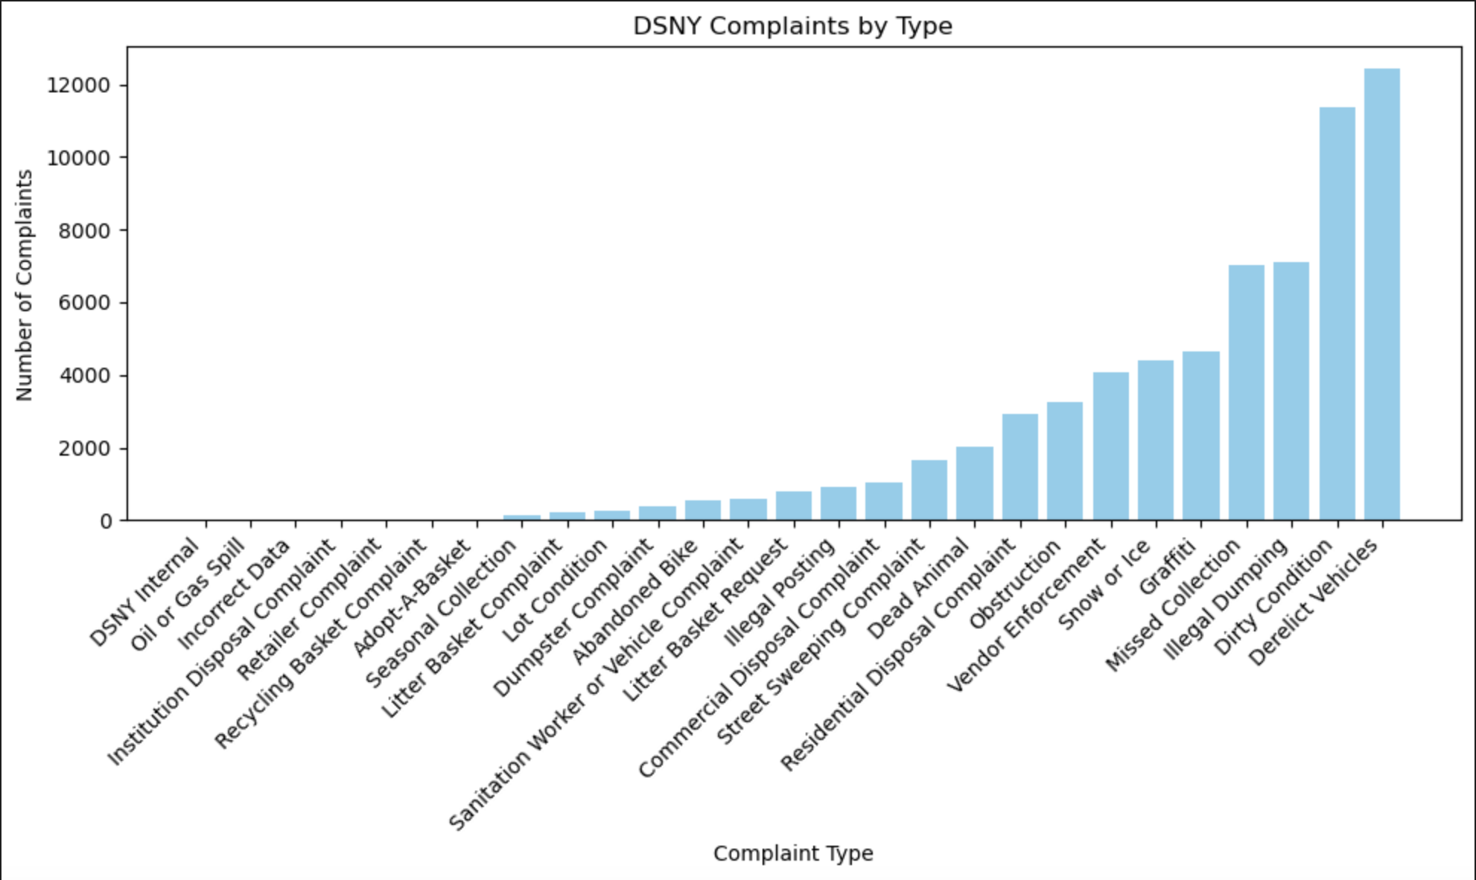
NYPD, HPD & DSNY Analysis
Team Members
Yesmelin Perdomo
Amanda Lor
Alyssa Jones
Daniel

Slide 18
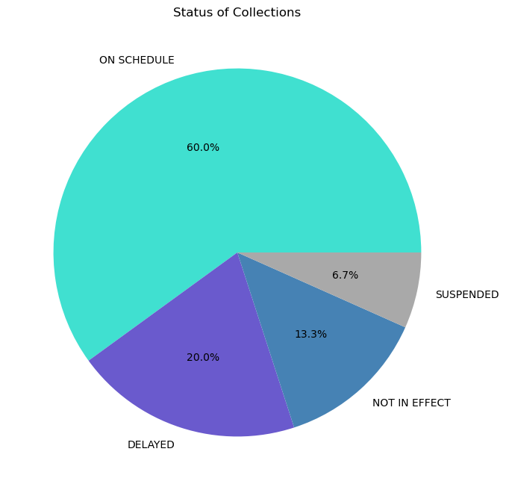
Trashcans Or Not?
Team Members
Yesmelin Perdomo
Amanda Lor
Alyssa Jones
Daniel

Slide 19
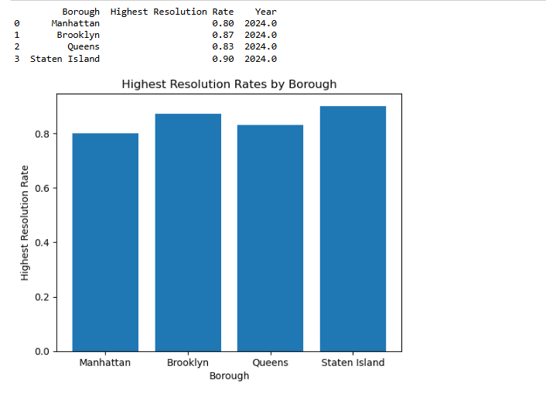
Highest Resolution Rate Per Borough
Team Members
Yesmelin Perdomo
Amanda Lor
Alyssa Jones
Daniel

Slide 20
Data Ethics
Team Members
Yesmelin Perdomo
Amanda Lor
Alyssa Jones
Daniel
Did not give out any personal information.
Gives relative location.
Data is meant for public access use.

Slide 21
Conclusion
Team Members
Yesmelin Perdomo
Amanda Lor
Alyssa Jones
Daniel
Per borough the highest complaint was illegal parking and heat/hot water.
NYPD had the highest call volume, due to noise complaints and illegal parking.
Sanitation in NYC, specifically trash is a big issue.
311 is not only crucial to the citizens of NYC, but shows that it could be implemented elsewhere, in order to provide citizens with assistance of non-emergent municipal tasks.

